Slide 1


Slide 2

AV – 355
COMPLEX ENGG PROBLEM PRESENTATION
Design, Mathematical Modeling and Hardware Implementation of a Two-Wheeled Inverted Pendulum Robot
Presented By :
NS Asfand (458959)
NS Hamza (467624)
NS Muqtadir (477812)
AC Inham (487315)
Number of Slides : 24
Instructor:
W/C Ahnaf

Slide 3
Sequence
Project Aim
Introduction
Methodology
Results
Conclusion

Slide 4
Project Aim
To design, model, fabricate and dynamically stabilise a two-wheeled inverted pendulum robot, and to justify the engineering transition from theoretical LQR state feedback to a hardware-realisable cascaded PID architecture.

Slide 5
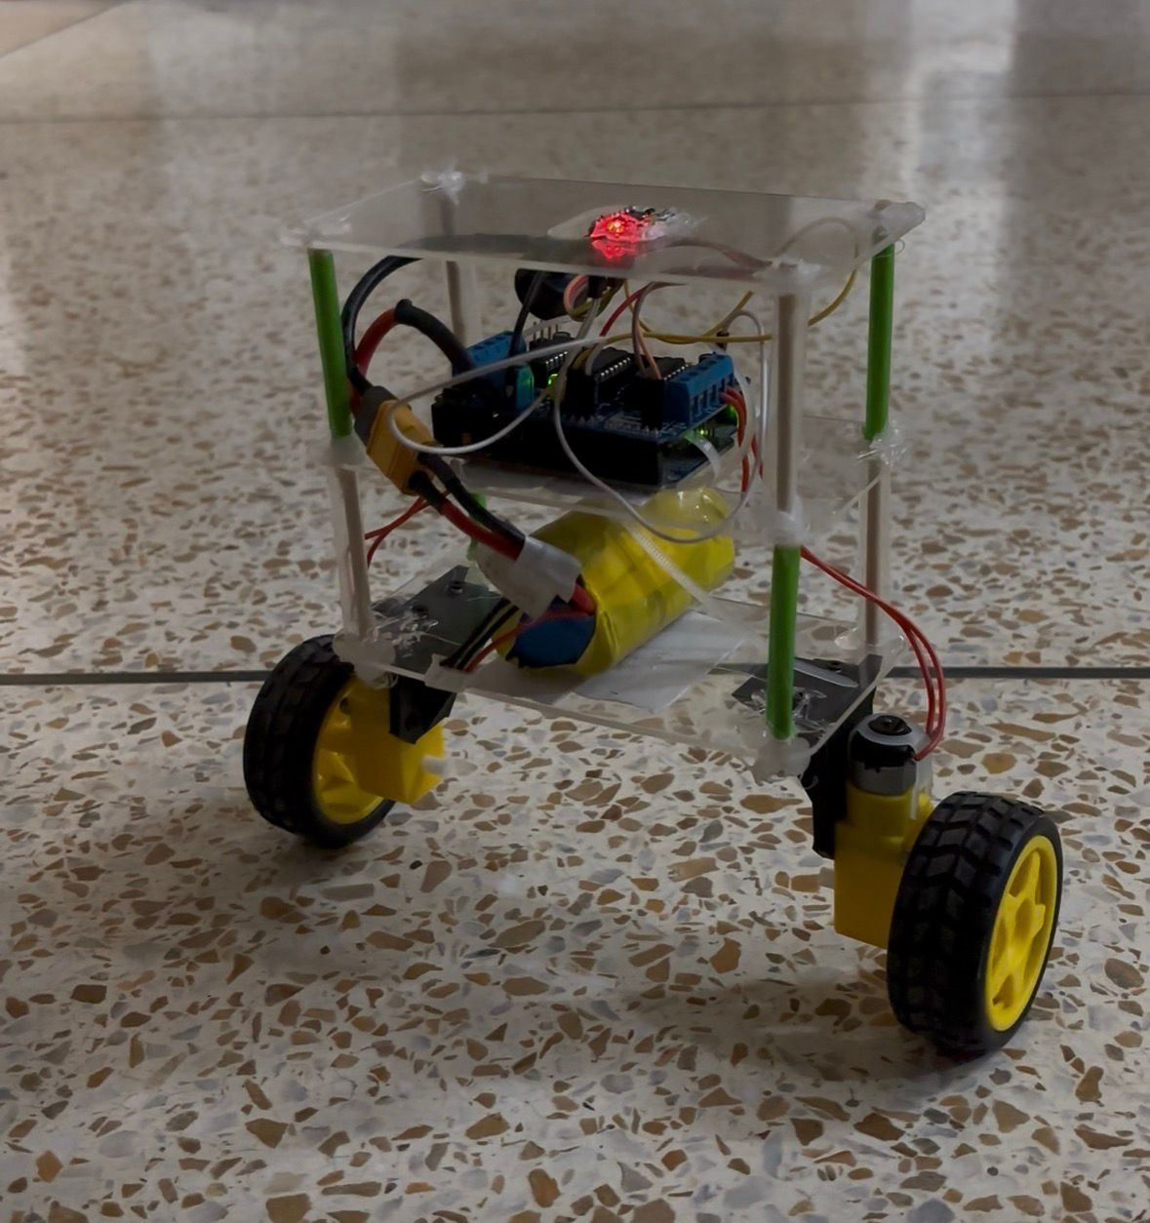
Introduction
Benchmark problem. The two-wheeled inverted pendulum is open-loop unstable, non-linear, multivariable and under-actuated.
Under-actuation. Two coaxial wheel torques must regulate three degrees of freedom: pitch tilt, yaw heading and cart displacement.
Aerospace relevance. Same dynamics govern launch vehicle thrust vector control, VTOL booster recovery.
Objective. Hold the unstable vertical equilibrium on real hardware, not only in simulation.

Slide 6
Methodology

Slide 7
State-Space Model and LQR Synthesis
State vector x(t) = [ x , ẋ , θ , ω ]ᵀ and control input u(t) = τ, giving ẋ(t) = A x(t) + B u(t) , y(t) = C x(t).
Quadratic cost: J = ∫ ( xᵀ Q x + uᵀ R u ) dt, where Q ≥ 0 penalises state deviation and R > 0 penalises actuator effort.
Riccati solution: the optimal gain is K = R⁻¹ Bᵀ P, with P the unique positive-definite solution of AᵀP + PA − PBR⁻¹BᵀP + Q = 0.
Optimal state-feedback law
u = −K x = − ( k₁ x + k₂ ẋ + k₃ θ + k₄ ω )
Every one of the four states must be measurable in real time, which is exactly where the hardware falls short.

Slide 8
Rebuttal: Why Pure LQR Was Not Realisable
Unobservable cart states
TT gear motors carry no optical or magnetic encoders. Double integrating accelerometer data for x drifts cubically within a few hundred milliseconds, so x and ẋ are not recoverable in real time.
Severe gearbox backlash
The 1:48 plastic spur train has a 2° to 5° dead zone. Every torque reversal across vertical adds phase delay that drives closed-loop poles into the right half plane.
Actuator and driver saturation
Aggressive LQR gains demand peak current beyond the L293D thermal limit of 600 mA and torque beyond the 0.8 kg·cm motor ceiling.
Asymmetric friction and stiction
The two motors break away at different thresholds, so equal PWM produces unequal wheel speed, continuous yaw rotation and diagonal falling.

Slide 9
State Estimation and Sensor Fusion
Accelerometer tilt: θacc = atan2(ay, az) × 180/π, drift free in steady state but corrupted by gear-mesh and structural vibration.
Gyroscopic rate: ωgyro = (gx − offset) / 131.0, immune to linear vibration but subject to slow thermal bias drift.
Axis alignment fix: early firmware paired atan2(ay, az) with gyro Y, giving near-zero rate integration and violent instability. Re-pairing with gyro X closed the loop.
Zero-rate calibration: a motionless routine averaged N = 300 samples to measure gyroX_offset = 11.40 LSB.
Discrete complementary filter at 150 Hz (Δt ≈ 0.008 s)
θk = α ( θk−1 + ωgyro,k Δt ) + ( 1 − α ) θacc,k , α = 0.98
98% short-term gyroscopic integration for phase-lag-free response, 2% gravitational anchoring to kill long-term drift.

Slide 10
Cascaded Control Architecture
IMU + Complementary Filter
θ , ω estimated at 150 Hz
Inner Balance Loop
u = Kp(θ − θdyn) + Kd ωgyro
Deadband Remap + Motors
PWM with trim and stiction offset
Anti-runaway cascade. Without encoders a setpoint error causes continuous unidirectional acceleration; the virtual velocity state leans the chassis in reverse and brakes the robot back to a stationary equilibrium.
Integral action disabled. Ki = 0 avoids phase-lag windup across the backlash dead zone.

Slide 11
Deadband Remapping and Friction Equalisation
A non-linear piecewise map lifts every non-zero controller command straight into the active torque region, past the static friction threshold.
This keeps the loop responsive at small tilt errors, where a raw PWM command would otherwise produce no wheel motion at all.
Independent motor scaling then equalises the mechanical resistance of the higher-friction left motor against the right.
PWM = DEADBAND + ((MAX_PWM − DEADBAND) / MAX_PWM) · |u| for |u| > 0, otherwise PWM = 0
Motor | Deadband (PWM) | Trim | Effect
Left (M4) | 50 | 1.16 | +16% torque to overcome higher stiction
Right (M1) | 36 | 1.00 | Reference actuator, no compensation

Slide 12
Hardware System Architecture
Subsystem | Component | Operational Specification
Microcontroller | Arduino Uno | ATmega324P, 16 MHz, 5 V logic
Attitude Sensor | GY-521 (MPU-6050) | 6-DOF IMU, I2C Fast Mode 400 kHz
Motor Driver | L293D Shield | Dual H-bridge, 74HC595 latch
Actuators | Dual TT Gear Motors | 1:48 spur gearbox, 3 to 6 V rated
Wheels | High-traction rubber | 66 mm diameter, 26 mm width
Power Supply | 3S Li-ion battery | 11.1 V nominal to 12.6 V full, 2200 mAh
Structure | 3-tier acrylic chassis | Vertically distributed mass layout
Power isolation: the L293D external power jumper is removed so motor transients never reach the 5 V logic rail. The IMU sits on the top tier, away from motor EMI.

Slide 13
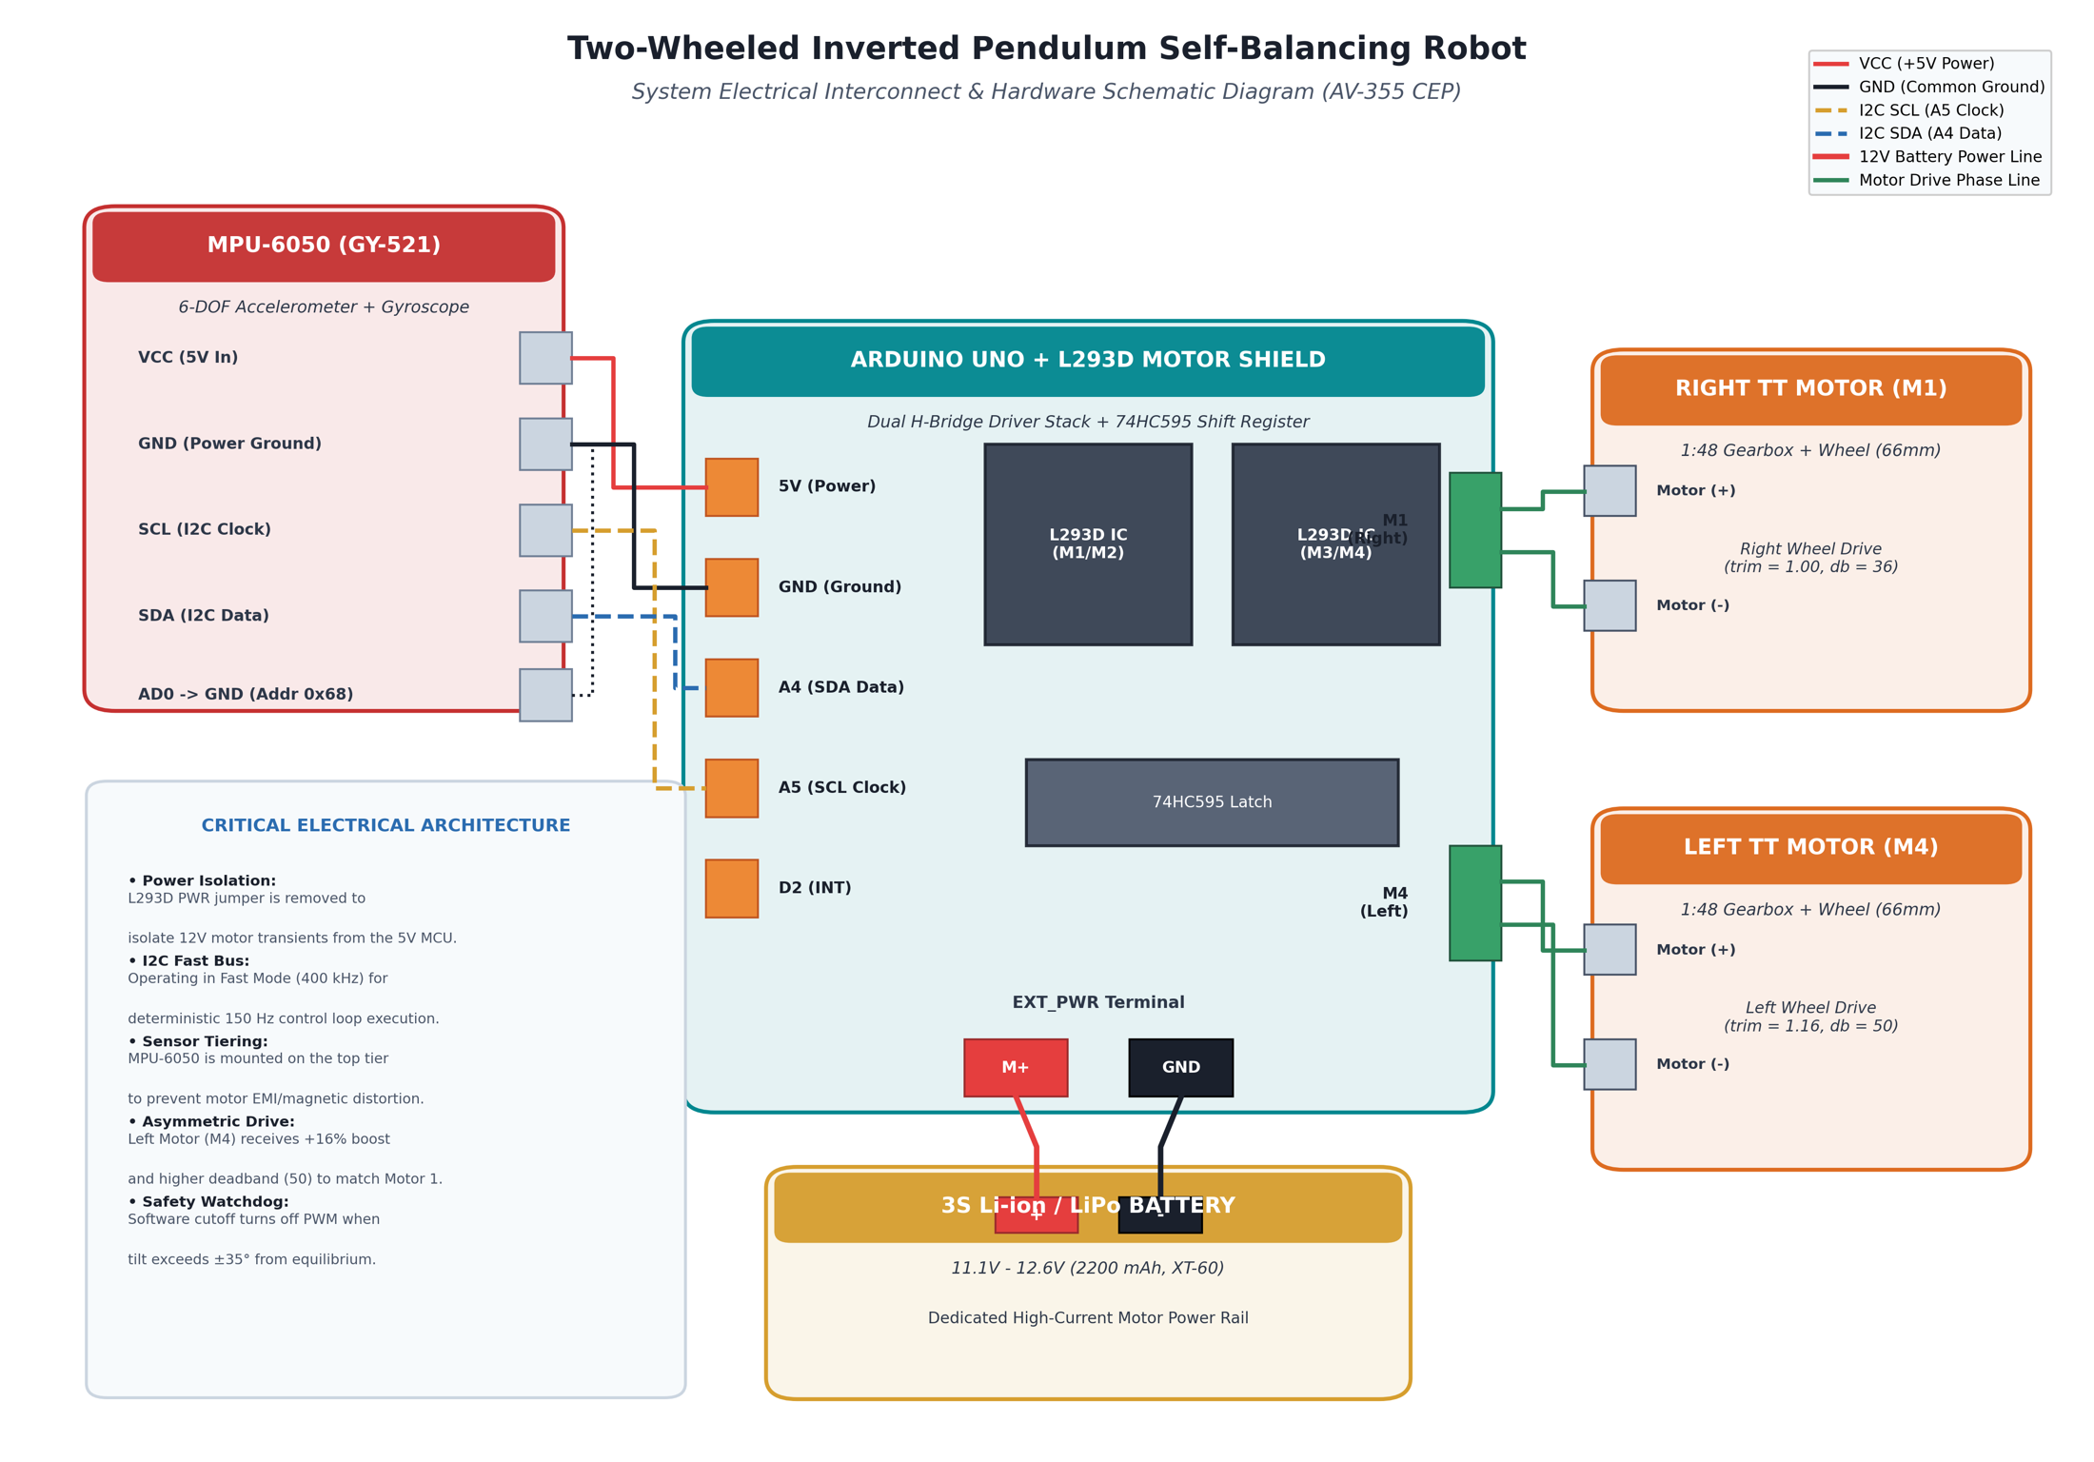
Electrical Interconnect Architecture
Power isolation
The L293D external power jumper is removed, keeping 11.1 to 12.6 V motor transients off the 5 V logic rail.
Fast I2C bus
SDA on A4 and SCL on A5, running 400 kHz Fast Mode for deterministic 150 Hz loop execution.
Sensor tiering
The MPU-6050 sits on the top acrylic tier, maximising distance from motor electromagnetic fields.
Asymmetric drive
Left motor M4 carries a +16% trim and a higher deadband to match the response of right motor M1.

Slide 14
Results

Slide 15
Progressive Tuning Trajectory
# | Iteration | Change Applied | Observed Outcome
1 | Pure high gain | Kp = 65.0, Kd = 2.5 | High-frequency chattering and violent limit cycles
2 | Axis correction | Gyro Y → Gyro X | Correct damping feedback established
3 | CG calibration | θsetpoint = −1.85° | True equilibrium found, offset by battery asymmetry
4 | Travel suppression | Kspeed 0.012 → 0.004, Kd = 1.35 | 50 cm rocking cycle eliminated
5 | Friction equalisation | trimL = 1.16, deadbandL = 50 | Asymmetric turning drift removed
Tuning was driven through an interactive serial command interface, allowing gains to be adjusted while the robot was balancing.

Slide 16
Final Locked Control Parameters
Parameter | Final Value | Physical Interpretation
Kp | 23.00 | Proportional restorative stiffness
Kd | 1.35 | Gyroscopic angular velocity damping
Ki | 0.00 | Disabled to prevent phase-lag windup
Kspeed | 0.0040 | Virtual translation damping
θsetpoint | −1.85° | Physical centre of gravity trim
gyroX_offset | 11.40 LSB | Hardware zero-motion sensor bias
DEADBAND L / R | 50 / 36 PWM | Static friction kickstart per motor
trimL | 1.16 | Left motor torque multiplier, +16%

Slide 17
Dynamic Performance and Disturbance Rejection
±0.8°
Steady-state attitude deviation from the equilibrium setpoint
0.65 s
Recovery time after a manual push disturbance of up to ±12°
≤ 30 cm
Bounded positional drift radius on smooth flooring

Slide 18
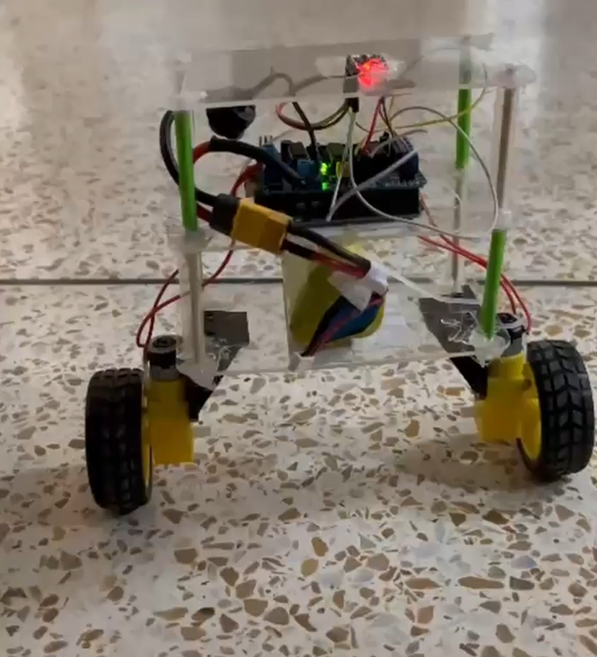
DEMONSTRATION

Slide 19
Conclusion

Slide 20
Conclusion
A physical two-wheeled inverted pendulum robot was modelled, fabricated and dynamically stabilised under tight hardware constraints.
LQR remains an elegant theoretical framework, but hardware realisation without wheel encoders exposed fundamental limits in state observability, motor stiction and gearbox backlash.
Pivoting to an empirically tuned cascaded dual-loop PID with direct gyroscopic rate damping, complementary filtering and asymmetric deadband compensation delivered robust stabilisation.
Attitude stays within ±0.8°, push disturbances up to ±12° recover in 0.65 s.
The transition itself is the engineering contribution: the design was driven by what the hardware could actually observe and actuate.

Slide 21
Future Recommendations
1. Magnetic rotary encoders
High-resolution encoders would restore observability of x and ẋ, enabling full state estimation and a true LQR implementation.
2. Backlash-free actuation
Closed-loop NEMA-17 steppers or BLDC gimbal motors would remove the 2° to 5° spur gearbox dead zone entirely.
3. Extended Kalman Filter
An EKF would replace the complementary filter for non-linear state estimation under sustained dynamic acceleration.

Slide 22
References
F. Grasser, A. D’Arrigo, S. Colombi and A. C. Rufer, “JOE: A mobile, inverted pendulum, two-wheeled robot,” IEEE Trans. Industrial Electronics, vol. 49, no. 1, pp. 107–114, 2002.
O. Boubaker, “The inverted pendulum: A ubiquitous benchmark in control technology,” Control Engineering Practice, vol. 21, no. 9, pp. 1265–1272, 2013.
K. Pathak, J. Franch and S. K. Agrawal, “Velocity control of a wheeled inverted pendulum by partial feedback linearization,” Proc. 44th IEEE CDC, pp. 3988–3993, 2005.
P. Castillo, R. Lozano and A. Dzul, “Real-time stabilization of an inverted pendulum on a two-wheeled vehicle,” IEEE Int. Conf. on Control Applications, pp. 2533–2538, 2006.
R. Mahony, T. Hamel and J.-M. Pflimlin, “Nonlinear complementary filters on the special orthogonal Group 1,” IEEE Trans. Automatic Control, vol. 53, no. 5, pp. 1203–1218, 2008.
S. O. H. Madgwick, A. J. L. Harrison and R. Vaidyanathan, “Estimation of IMU and MARG orientation using a gradient descent algorithm,” IEEE ICORR, pp. 1–7, 2011.
D. E. Kirk, Optimal Control Theory: An Introduction. Dover Publications, 2004.
K. Ogata, Modern Control Engineering, 5th ed. Prentice Hall, 2010.

Slide 23
THANK YOU

Slide 24
QUESTIONS?
CEP: Two-Wheeled Inverted Pendulum Self-Balancing Robot

